Slide 1

BENV0091 Lecture 5: Dates and Times
Patrick de Mars

Slide 2
Lecture Overview
Intro to dates, times and the lubridate package
Time series forecasting (Renewables Ninja)
Upcoming competitions!

Slide 3
Challenges of Dates and Times
Handling dates and times (AKA date-times) in R (and other languages) can be challenging
There is no single format for dates and times:
9am 25th Dec 2021
2021-12-25 09:00
9:00:00 25/12/2021
Furthermore, local time zones (including daylight savings) mean that the time isn’t the same everywhere in the world
Coordinated Universal Time (UTC) is the standard time zone that is most widely used as a reference point, but often the local time is more informative
Plus leap years (and even leap seconds) can pose problems!

Slide 4
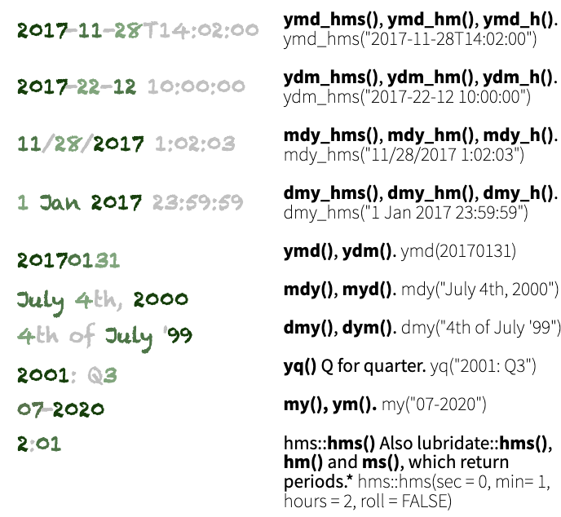
Parsing Dates and Times
From the lubridate cheat sheet
Dates and times should be treated as their own data types: not as strings!
There are 3 types of date/time object:
date
time
date-time (AKA POSIXct)
When you read in data with a timestamp or date column, it will often not be automatically converted to date/time data
The lubridate package has intelligent functions like `ymd()` or `dmy_hms()` for converting to date/time objects
Identify the order of years, months, days, hours, minutes and seconds, then apply the relevant function on the right
Task: convert the following dates/times to date or date-time variables:
March 3rd 2003
16:00:00 14.11.2030
Tuesday 2nd August 1966 7:30pm

Slide 5
Converting Time Zones
When you create a date-time object, the time zone will be UTC unless you specify otherwise with the `tz` argument
E.g. ymd_hms(d, tz = …)
The time zone codes (which should be passed as strings) and UTC offsets are taken from the tz database and generally have the form “region/place”
The tz database takes into consideration daylight savings time when necessary
Convert between timezones using `with_tz()`
Task: create a date-time variable for 1st April 1980 5am with the UTC time zone, then convert to:
Europe/London (06:00 BST)
Asia/Tokyo (14:00 JST)
America/Los_Angeles (21:00 PST)
TZ Name | UTC Offset
Africa/Cairo | +02:00
Pacific/Honolulu | -10:00
Europe/Brussels | +01:00
America/Chicago | -06:00

Slide 6
Date-Time Arithmetic
There are some subtleties when adding or subtracting date/times: you must consider whether you want to consider discontinuities in the time line.
Suppose you want to know the time 3 hours after Saturday 30th October 2021 at 11pm (the night the clocks go back): 2am or 1am?
Date/time data can be added or subtracted
Using `seconds()`, `months()`, `years()` etc. gives creates a period
Adding/subtracting a period from a date-time returns a new date-time
Subtracting two date-times returns a difftime
Tasks:
Calculate the time in 123456789 seconds from now
Calculate your age in seconds by taking the difference between today and your DOB
now() gives the current time as a date-time object

Slide 7
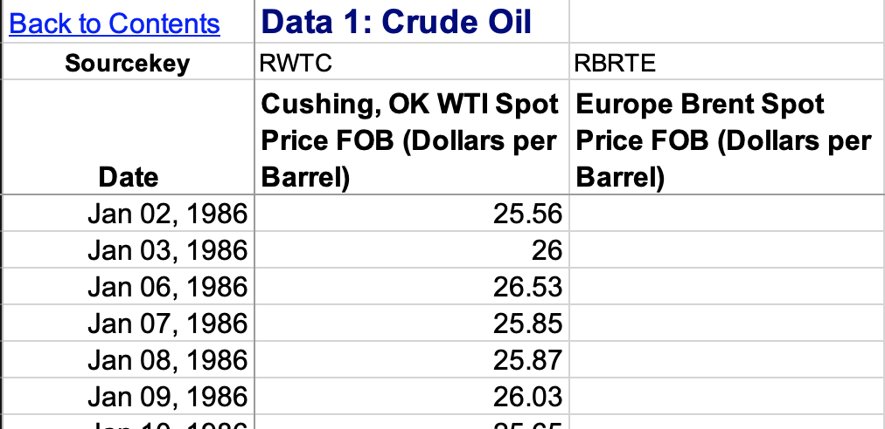
Filling NAs
Task: read the crude oil price data using `read_excel()` from the readxl package:
Skip the first two rows
Choose the sheet named “Data 1”
Rename the columns (see right)
This daily crude oil price (WTI) data has a few missing values
Task: count the number of NAs in the WTI column
We can get rid of these values with `drop_na()` but we will lose valuable data!
Alternatively, we can attempt to fill in (impute) the missing data points

Slide 8
Imputation
Methods which impute missing values of column X using information from column X alone are univariate. Methods include:
Taking the mean, max or other statistic
Interpolation (linear, splines…)
Carry forward/backward
Multivariate imputation uses other variables to predict the missing values
Univariate methods are particularly appropriate for time series, because often adjacent values are similar to each other
Task: use na.approx() from the zoo package to fill the NA values in the WTI oil price time series
zoo functions for univariate imputation:
na.approx()
na.locf()
na.aggregate()
na.spline()
R packages for multivariate imputation:
missForest
mice
Amelia
mi

Slide 9
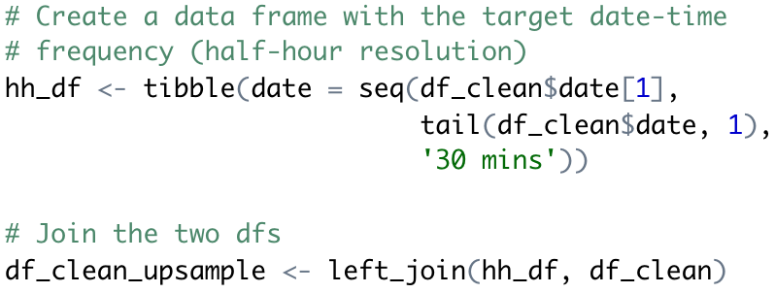
Resampling Time Series
Often, we want to change the resolution of a time series to match another data set
Electricity metered at 30 minute resolution, gas metered at 1 hour resolution
Daily oil prices, half-hourly electricity prices
The methods for resampling depend on whether we want to increase or decrease the resolution:
Reduce resolution → aggregate
Increase resolution → impute or aggregate
Task: upsample the oil price data to 30 minute resolution
Task: impute the missing WTI data with a method of your choice
One upsampling method: join the data frame to a separate data frame with the desired date-time resolution

Slide 10
Moving Averages
A useful and interpretable way to indicate a trend over time is a moving average
Moving (or rolling) average typically calculates the mean over a rolling window
The `rollmean()` function from zoo is a good option for calculating rolling averages (or you can write your own function!)
Code available from the Github repo

Slide 11
Introduction to Forecasting

Slide 12
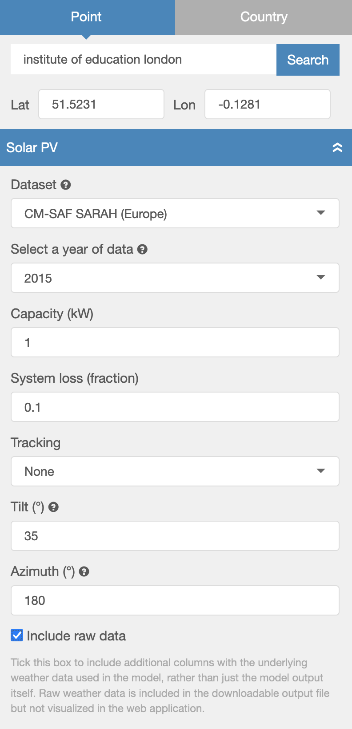
Data: Renewables Ninja
Renewables Ninja runs simulations of hypothetical solar PV or wind turbines for a specified location, based on weather data
We will use hourly simulated solar PV production for a 1 kW solar panel on the Institute of Education building (51.5231, -0.1281)
Task: read the data into an object called `ninja`
Note there are two time columns:
time (UTC)
local_time (considers local time zones, including daylight savings)

Slide 13
Retrieving Date-Time Components
Once you have a correctly formatted a date-time, you can easily retrieve components such as week, hour, year etc.
Task: use mutate() to add hour, week and date columns to `ninja`
Task: produce the plot on the right hand side!
geom_col() shows the mean production by hour
geom_errorbar() shows the range
Use week() to retrieve week number from a date-time, year() to retrieve year etc.

Slide 14
Autocorrelation
Use acf(vector, lag.max = N) to plot the autocorrelation function for vector with a maximum lag of N
Autocorrelation measures the correlation between a series and a delayed version of itself
It is useful for determining patterns and periodicity of time series, which can be useful for feature generation
Task: produce the plot on the right with the `acf()` function

Slide 15
Solar PV Forecasting
Our task will be to forecast the (simulated) solar PV output 24 hours ahead
In this lecture we will adopt a machine learning approach, using supervised learning methods that are equally applicable in non-time series contexts
However, there is a rich literature of traditional time series forecasting methods, including:
Exponential smoothing
Autoregressive and moving average models, e.g. ARMA, ARIMA

Slide 16
Data Pre-Processing and Train/Test Splitting
It is important to get the data pre-processing and train/test split steps right for forecasting tasks as there are serious risks of data leakage:
Including measurements from the target time as features in the model
Including adjacent observations in test and train data
To avoid (1), observations from the target period shouldn’t be used to train the model!
To avoid (2), the test set is often set to be the last segment
Task: split the data such that all pre-October data is for training; the remainder is for testing

Slide 17
Cyclical Date/Time Features
Dates and times are cyclical: hour 24 is adjacent to hour 1, December is adjacent to January
If we encode dates/times as numeric variables, then we cannot immediately capture the cyclical nature
A categorical encoding could also work, but this loses the continuous nature of dates and times and increases the dimensionality of the data significantly
One option to create a numeric (continuous) encoding that captures the cyclical nature of dates/times is to use the sine and cosine functions
Task: use mutate() to create new variables for hour and weeks:
sin_week, cos_week
sin_hour, cos_hour
For variable with period T:
cos_var = 2π cos(var / T)
sin_var = 2π sin(var / T)

Slide 18
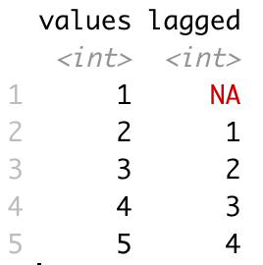
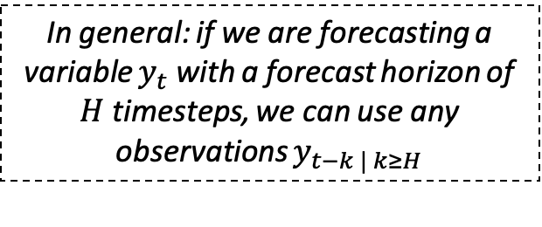
Lagged Predictors
In general: if we are forecasting a variable $y_{t}$ with a forecast horizon of $H$ timesteps, we can use any observations $y_{t−k | k≥H}$
Lagged explanatory variables are among the most important inputs for forecasting models
We can include observations of the target variable and other explanatory variables from any time before the forecast horizon, but not after
Depending on the context, you may want to include 24hr, 1wk, 1yr lagged variables: you can use autocorrelation to inform your decision
1 year might be useful for solar PV, but we don’t have enough data ☹
Use lag(vector, N) to create a new vector that is lagged by N steps, with the initial values padded with NA
Lagged values with N=1

Slide 19
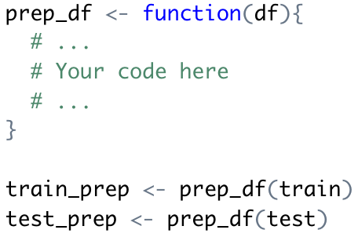
Pre-Processing
Task: create a function for pre-processing your data
Add 24 hour lagged variables for:
Electricity
Direct irradiance
Diffuse irradiance
Temperature
Add the sine and cosine transforms of week and hour variables
Task: pre-process your training and testing data separately with the cleaning function
Task: drop the NA values from your training data

Slide 20
Fitting Models
This week we will introduce a new model: the random forest
Random forests fit many different decision trees using different features (sampled randomly) and with different data
The forest of trees are used to calculate an average prediction
Task: fit the following models to the training data
Linear Regression
Decision Tree (minsplit = 10)
Random Forest (ntree = 200)
Use randomForest(formula, data, arguments…) to fit a random forest model

Slide 21
Evaluating the Models
Task: calculate the predictions based on the training data, storing them in a data frame with the following columns:
Timestamp
Actual value
Linear model prediction
Decision tree prediction
Random forest prediction
The simplest forecast assumes that the forecast is the same as the last observation: called a naïve forecast or persistence forecast
Task: add a naïve (persistence) forecast to your predictions data frame
Task: calculate the RMSE of each of the models

Slide 22
Plotting Residuals
Now we will investigate the residuals for each model
Task: plot the predicted vs. actual values for each model
Task: colour each point by quarter
Task: plot the residuals of the random forest model with respect to time

Slide 23
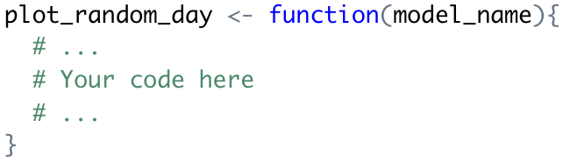
Model Evaluation on Test Data
We will now employ our models to predict the solar PV output on the out-of-sample data (October onwards)
Task: make your predictions on the (pre-processed) test data
Task: calculate the RMSE of each model on the test data
Bonus task: write a function that plots the predicted and actual time series for a specified model and random day (see right)
Which model performed best? What are the limitations of the random forest model?

Slide 24

Further Reading
Forecasting: Principles and Practice by Rob J Hyndman and George Athanasopoulos
Excellent (free) book with R examples and more focus on traditional time series methods

Slide 25
Upcoming Competitions and Challenges

Slide 26

Western Power Distribution: Upcoming Challenges
The Energy Systems Catapult (ESC) and Western Power Distribution (WPD) are launching three short (3-week) data science challenges
First challenge investigates whether low resolution demand data (e.g. 30-min) can be used to estimate short duration, high resolution events (such as 1-min demand spikes)
Kick-off event: 11/11/2021
Excellent opportunity to practice your data science skills; meet like-minded people working in the sector; study a real-world problem

Slide 27
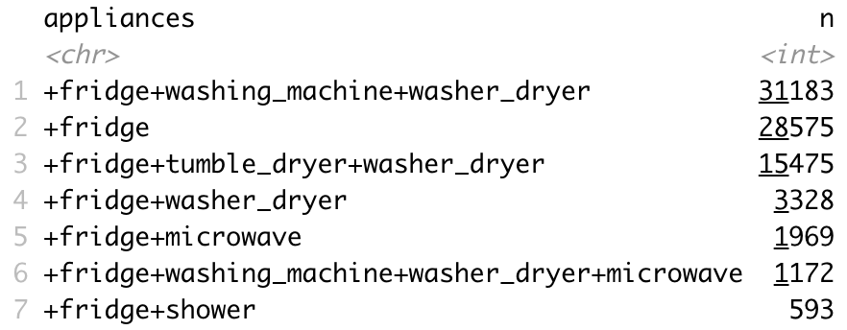
Kaggle Competition
Correlation of training features
Today we are launching a Kaggle competition looking at non-intrusive load monitoring (NILM)
Your task is to predict appliances being used based on recorded samples of voltage and current
75% of the data is available in a training data set, 25% is held back in a test set
You will be marked on classification accuracy
£100 for winner; £50 for 2nd and 3rd places!
Deadline is Wednesday 17th November @ 11:59pm
Class labels (28 in total)

Slide 28
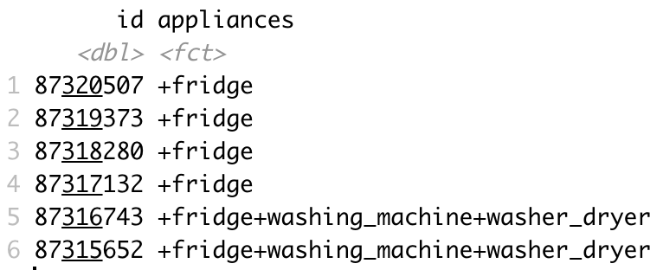
Minimum Viable Submission
Make a submission is as simple as uploading a CSV file with 2 columns:
id (corresponding to the ids in the test set)
appliances (your prediction)
We have made available a minimum viable submission: fitting a model, making predictions and saving the submission to a .CSV file
If nothing else, try submitting an improved decision tree with some hyper-parameter tuning!
More details are available on the Kaggle webpage ☺ Good luck!
Submission format
https://www.kaggle.com/c/esda-nilm-2021

